Slide 1
Recommending items to user using data mining and machine learning
Advanced Database Topics Project

Slide 2
TEAM MEMBERS
SALEHIN RAHMAN KHAN ID - 110016396
AHMAD NAJEEB ID - 110024446
SHEIKH SADAF TASIN ID - 110022203
YEHAN LI ID - 104215665
YIDI DENG ID - 110009058

Slide 3
INTRODUCTION
Nowadays, Recommender systems support the online customers in their decision making and buying process. Recommender systems are an active research topic in the data mining and machine learning fields. Data mining techniques have played an important role in the design and implementation of recommender systems.

Slide 4
TOOLS WE USED
Python 3+
SQL
MySQL workbench
XAMPP Server
Pycharm
Regular Expressions

Slide 5
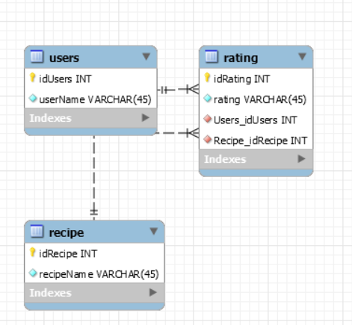
DATABASE DESIGN

Slide 6
CRAWLER AND DATA MINING WITH REGULAR EXPRESSIONS
Build With python
Used Regular Expressions:
RE * : Zero or more occurrences
RE +: One or more occurences
Different functions for each datapoint data collection:
getSourcecode: Helps to get source code in html tag format
getUsers: get users by their user id
Getrecipe: get recipe by the recipe id by sourcing the <title> tag
getRatings: get user ratings but in relation to user id
Used three vital libraries for this project
Requests : to crawl a specific webpage
Re: to use regular expressions
Databasecon: to connect with database which is built with mysql workbench

Slide 7
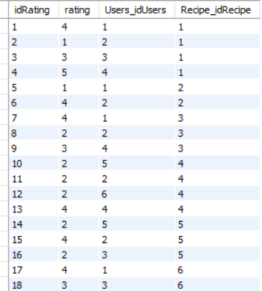
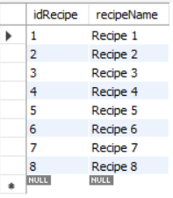
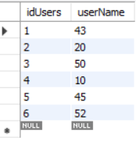
STORING DATA
Using the databasecon library we used insertion, update queries.
Before finalizing the queries we tested the queries in the MySQL workbench

Slide 8
SVD ALGORITHM
SVD is a matrix factorisation technique, which reduces the number of features of a dataset by reducing the space dimension from N-dimension to K-dimension (where K<N). In the context of the recommender system, the SVD is used as a collaborative filtering technique.

Slide 9
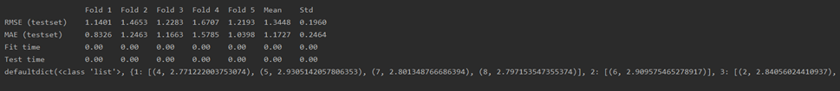
RECOMMENDATION SYSTEM
Used Surprise-Scikit library
Used Pandas for dataset
Trained the dataset with SVD algorithm
Predicted Result is Given Below with RMSE & MAE

Slide 10
EXISTING WORK
Data Mining Based Recommendation System Using Social Websites, IEEEXplore.
Travel Time Prediction using Machine Learning and Weather Impact on Traffic Conditions, IEEEXplore.
The application of Data-Mining to Recommender Systems. - J Ben Schafer, PhD
Discussed in depth of challenges, opportunities and methods of data mining for user recommendation.

Slide 11
LIMITATIONS
We had to built a demo website to crawl and mine data.
Real life website crawling and mining was possible but did not do it due to data theft risk.
Data privacy and security was an issue.
Explore other algorithm suggestions that may perform even better.

Slide 12
FUTURE WORK
Build it with a better User Interface.
Build with an option to use more than one algorithm.
To build a better crawler with more datapoint to extract.

